Slide 1
Do Drug Combinations that Show Similar Activities also Show Similar Synergies?
Update 7/21/17

Slide 2
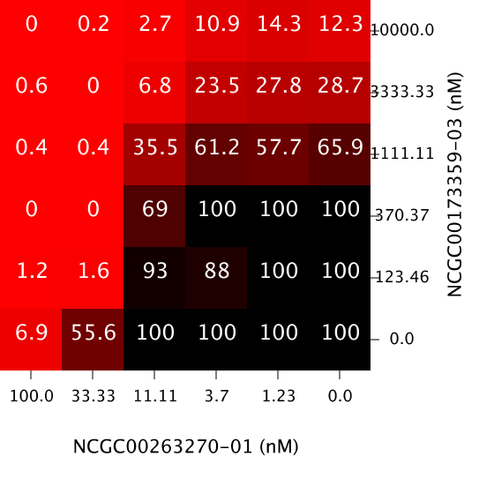
Recap

Slide 3
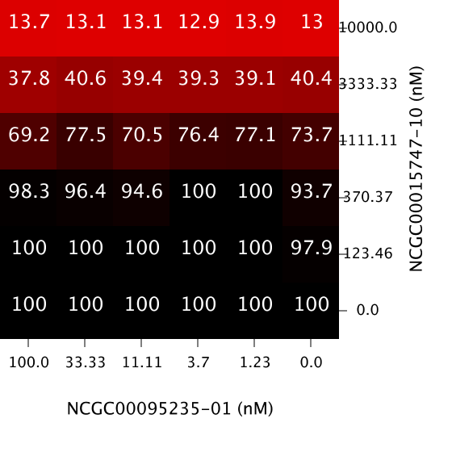
Recap

Slide 4
Assay 6410
Why Assay 6410?
- Smaller size (24 combinations of 2 drugs)- helpful for quickly trying out and fixing functions
- Has a few “medium” and “bad” matrices- functions have to work with them

Slide 5
Step 3- Methods to Compute Similarity (from workflow in project’s google doc)
Methods (each row is different method)
RMSE
Euclidean
KS Test
Syrjala Distance
Comparing Response Matrices (left column)
Comparing bliss matrices (right column)

Slide 6
Step 4- Explore correlation of single agent similarity with combination similarity
Will work on later this week

Slide 7
Step 5- Explore similarity of response surfaces vs similarity of synergy surfaces
Plotting similarity of synergy matrices ~ similarity of response matrices
Using the 4 different ways (4) of computing similarity
Correlation?

Slide 8
5.2- Discordant Pairs
Points on x axis: where response matrices are different but synergy matrices are similar
Points on y axis (opposite of above): where response matrices are similar but synergy matrices are different
Visualization of where all of the discordant pairs- comparing 4 methods

Slide 9
Malaria Assays- 1764, 1763, 1761

Slide 10
RMSE for the Three Assays- Similarity of Response Matrices and Synergy Matrices

Slide 11
Syrjala Distance for the Three Assays- Similarity of Response Matrices and Synergy Matrices

Slide 12
A Correlation?

Slide 13
Larger View of One of the Assays

Slide 14
Discordant Pairs

